Slide 1


Formfest Title Slide

Slide 2
Form-ing an Open Source Culture in Federal Agencies
Open Source Program Office (OSPO)
Digital Service at Centers for Medicare and Medicaid Services
https://github.com/DSACMS/decks/blob/main/formfest2025.pdf

Slide 3
Formfest 2025 Agenda
Who are we?
What is CMS?
What is the Digital Service at CMS?
What is Open Source?
What is an Open Source Program Office?
What is the SHARE IT Act?
What is our SHARE IT stack?
share-it-landing-page
codejson-generator
automated-codejson-generator
index-generator
DEMO TIME!
What is the potential impact?
What questions and feedback do y’all have? (Q&A)

Slide 4






Sachin Panayil
Software Engineer Open Source Program Office
Remy DeCausemaker
Open Source Lead Digital Service at CMS
Open Source Program Office
Dinne Kopelevich
Software Engineer Open Source Program Office
Isaac Milarsky
Software Engineer Open Source Program Office
Natalia Luzuriaga
Software Engineer Open Source Program Office

Slide 5
“CMS is the federal agency that provides health coverage to more than 160 million through Medicare, Medicaid, the Children's Health Insurance Program, and the Health Insurance Marketplace. CMS works in partnership with the entire health care community to improve quality, equity and outcomes in the health care system.”
What are the Centers for Medicare and Medicaid Services? (CMS)
https://www.cms.gov/about-cms

Slide 6
Who we serve
Who we serve: The American People
67.8
82.3
21.1
M
M
M
Medicare Beneficiaries
(2023)
Medicaid Beneficiaries
(2023)
Healthcare.gov
(2023)
https://data.cms.gov/fact-sheet/cms-fast-facts
https://www.cms.gov/files/document/health-insurance-exchanges-2024-open-enrollment-report-final.pdf

Slide 7
Who we serve: Taxpayers
Who we serve: Taxpayers
1.76
1.05
846
$
$
$
T
T
B
Total Medicare Payments
(FY 2024)
Total Medicaid Payments
(FY 2024)
CMS Budget
22% of the
federal budget
(FY 2024)
https://data.cms.gov/fact-sheet/cms-fast-facts
https://www.govinfo.gov/content/pkg/BUDGET-2025-BUD/pdf/BUDGET-2025-BUD.pdf
https://www.cms.gov/files/document/cms-financial-report-fiscal-year-2024.pdf

Slide 8
Who we serve: The Healthcare System
Who we serve: The Healthcare System
6,613
1.5
22
M
%
CMS Employees
(FY 2024)
Health Care Providers
(2024)
National Health Care Spending is Medicare
(2024)
https://data.cms.gov/sites/default/files/2025-04/CMSFastFacts2025_508.pdf
https://www.cms.gov/oact/tr/2024
https://www.cms.gov/files/document/cms-financial-report-fiscal-year-2024.pdf

Slide 9




What we do
What does the Digital Service at CMS do?
We transform the US Healthcare System by
Improving design and user experiences
Delivering value to government, providers, and patients
Modernizing systems
Participating in Policy Development

Slide 10






How we do it
How do we do it?
We deploy small groups of designers, engineers, and product managers on a "tour of duty" to work alongside dedicated civil servants.
These multidisciplinary teams bring best practices and new approaches to support government modernization efforts.

Slide 11
What is open source
What is Open Source Software?
Source code that anyone can inspect, modify, enhance, and share.
96% of all commercial software contains open source code, representing $8.8T of value if it had to be rewritten from scratch.
https://www.blackduck.com/blog/open-source-trends-ossra-report.html
https://library.hbs.edu/working-knowledge/open-source-software-the-nine-trillion-resource-companies-take-for-granted

Slide 12
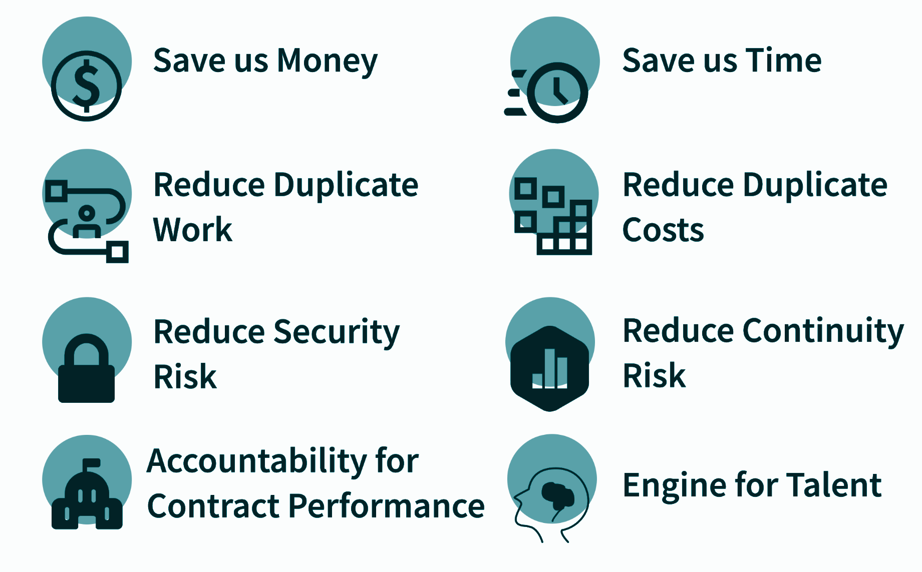
What does an OSPO do
What does an Open Source Program Office (OSPO) do?
An Open Source Program Office (OSPO) serves as the center of competency for an organization's open source operations, strategy, and structure.
An OSPO is responsible for defining and implementing programs, policies, and projects to guide these efforts.
30% of Fortune 100 companies have implemented an OSPO, with 84% of OSPOs developing or managing GenAI infrastructure.
CMS is the first United States Federal Agency to implement this private-sector styled approach to an Open Source Strategy.
https://github.blog/open-source/maintainers/why-companies-are-starting-ospos/
https://www.linuxfoundation.org/hubfs/LF%20Research/lfr_ospo24_infogfx_111824.png?hsLang=en

Slide 13
Summary
SHARE IT Act: Summary
"This bill requires federal agencies to ensure that custom-developed code (i.e., source code that is produced under an agency contract, funded exclusively by the federal government, or developed by federal employees as part of their official duties) and certain technical components of the code such as architecture designs and metadata are
(1) owned by the agency,
(2) stored at no less than one public or private repository, and
(3) accessible to federal employees under certain procedures. Agency contracts for custom-development of software must acquire and exercise rights sufficient to allow government-wide access, sharing, use, and modification of any custom-developed code.
The bill does not apply to source code that is classified, developed primarily for use in a national security system, or developed by an element of the intelligence community. An agency's office of the chief information officer may exempt source code from being shared or made publicly accessible to protect individual privacy." Bill Summary
https://www.congress.gov/bill/118th-congress/house-bill/9566

Slide 14
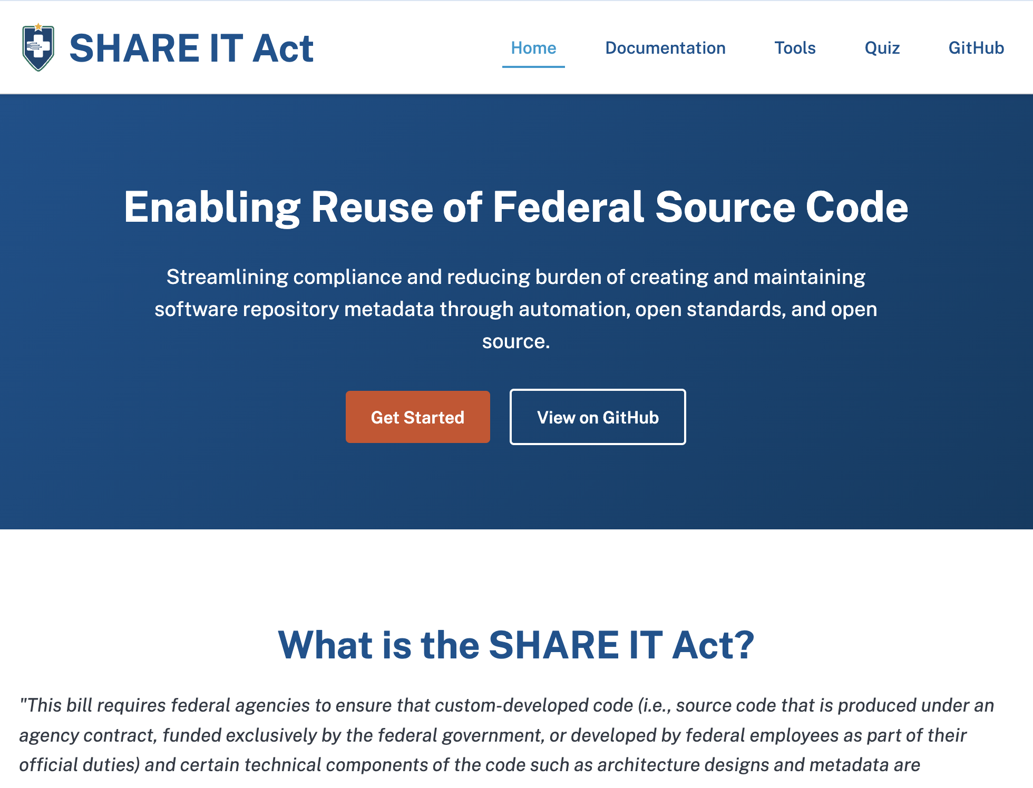
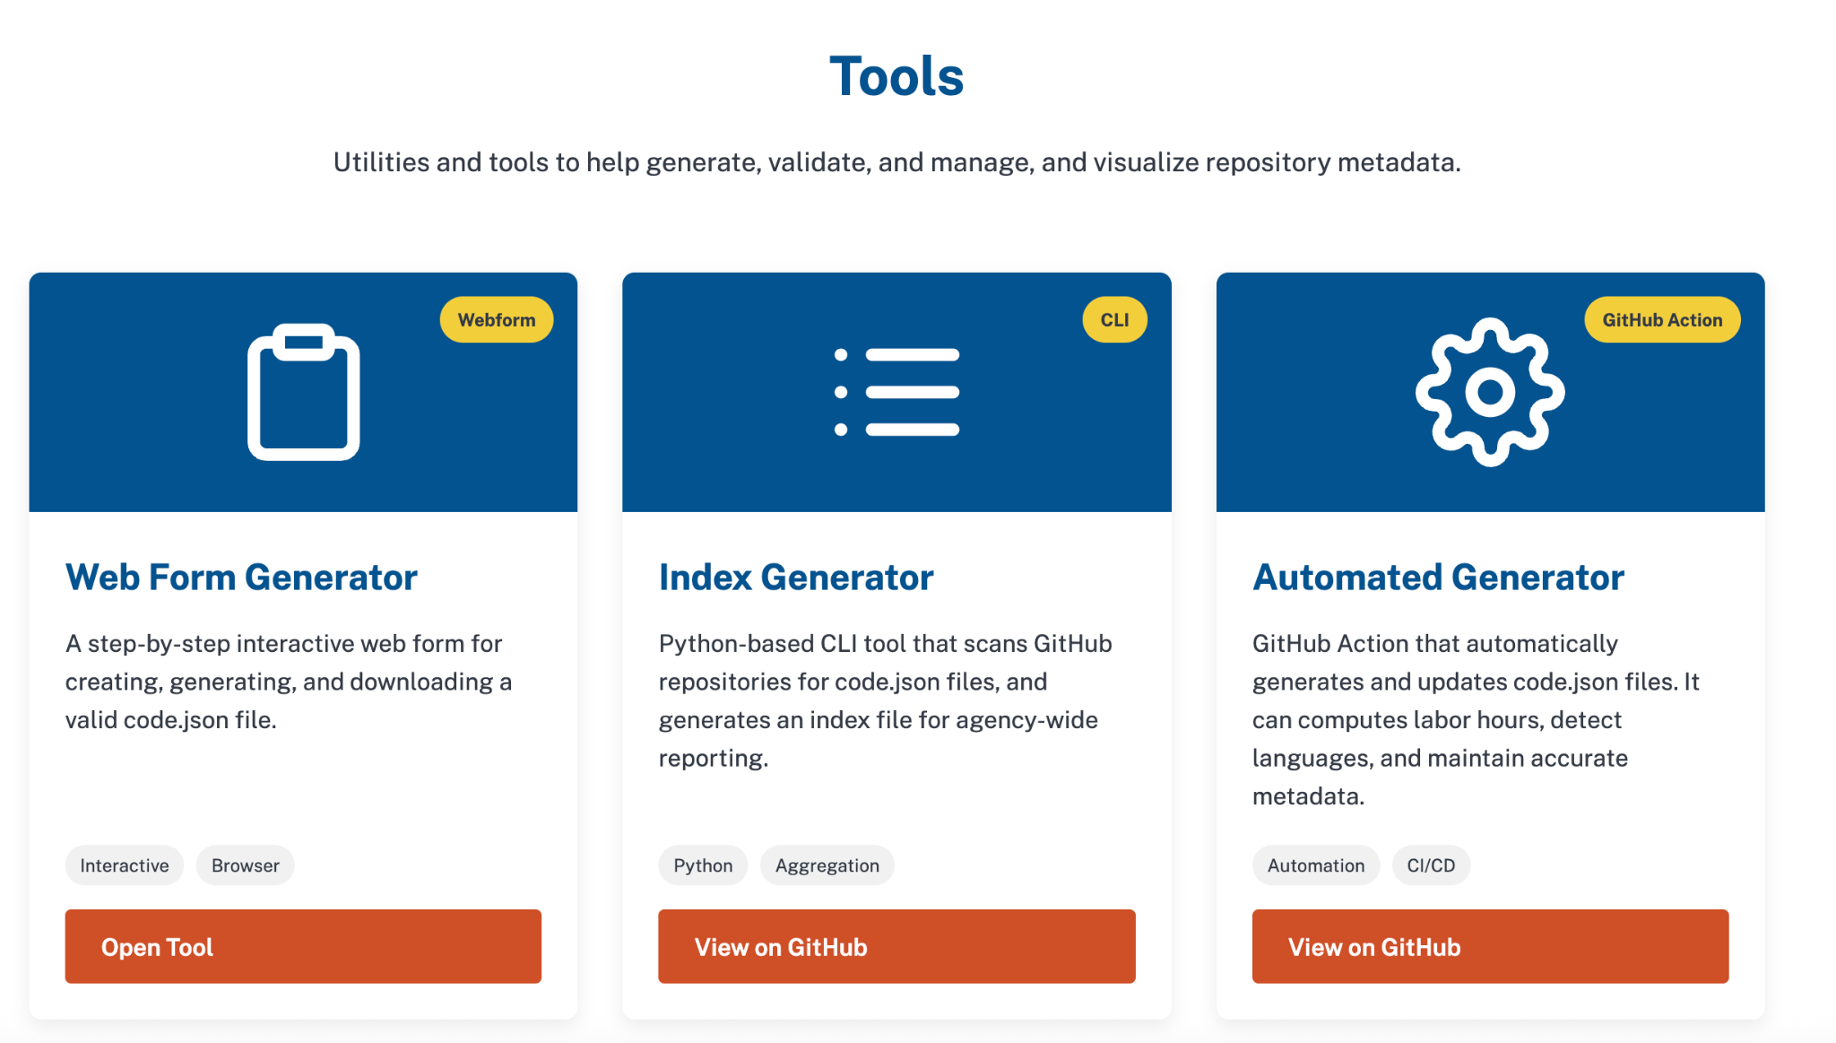
SHARE IT Act Landing Page
SHARE IT Act Landing Page
Website with legislative information, guidance, and a toolkit: https://dsacms.github.io/share-it-act-lp/
14
Notes:
Dinne

Slide 15
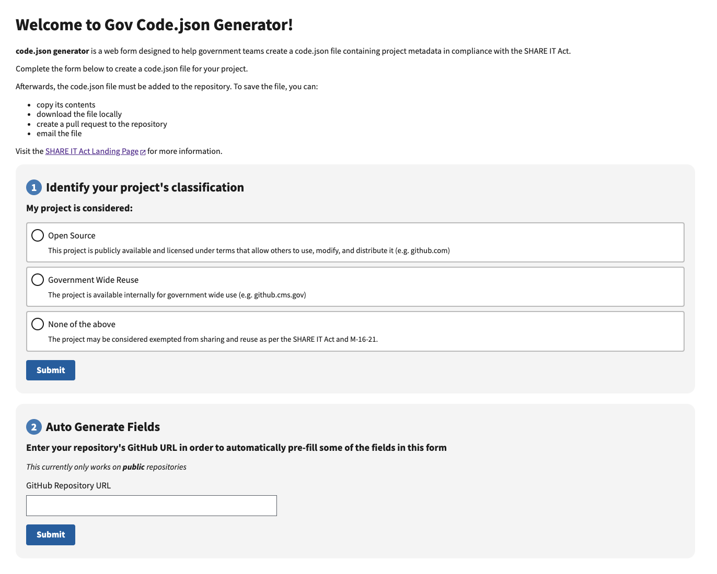
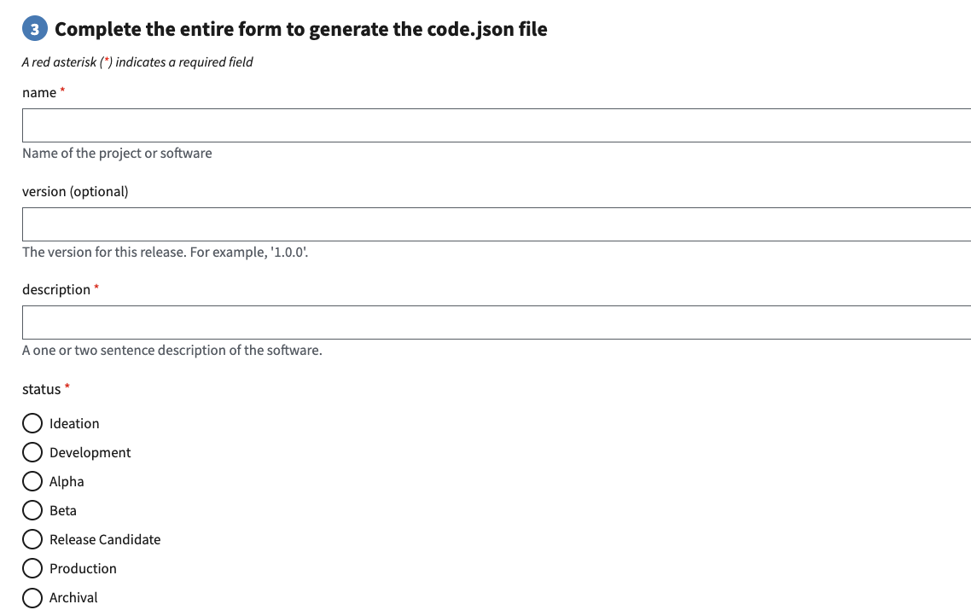
codejson-generator
A webform where users can enter required metadata and generate a code.json file to add to their repository
Features include:
Offers four methods to save metadata: copy, download, send pull request, email
Automation of 14 out of 34 fields using GitHub API
Includes an Exemption Classification Checklist
https://dsacms.github.io/codejson-generator/
Notes:
Natalia

Slide 16


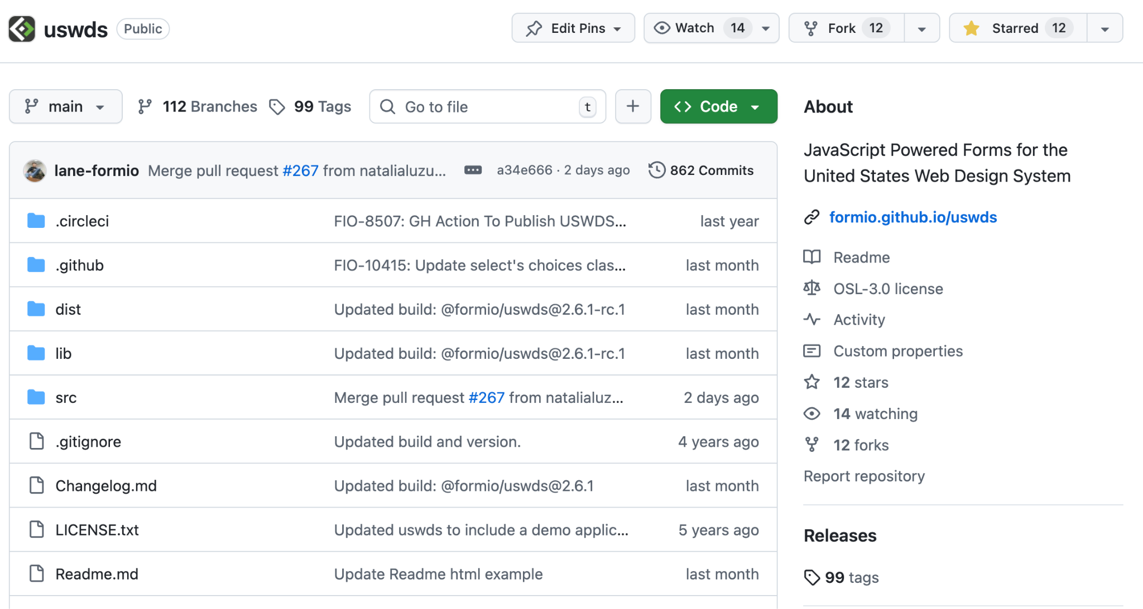
Form.io
U.S. Web Design System
An open source platform for building forms
Offers a United States Web Design System (USWDS) template
Creates a tool that ingests json schemas and converts them into a form with components, mapping to each field using form.io
codejson-generator ingests code.json schema file and produces a form for our metadata collection
https://github.com/formio/uswds
Notes:
Natalia
Explain reasons of why we decided to use form.io

Slide 17
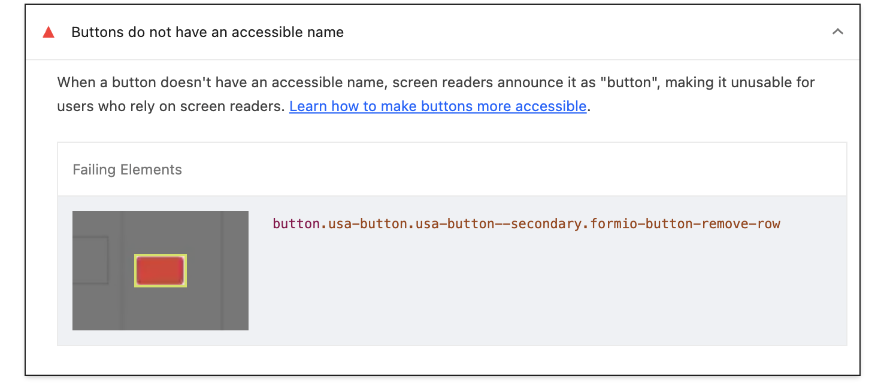
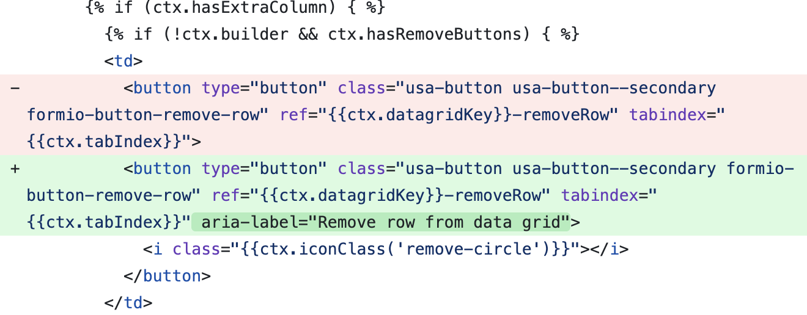
Contributions to USWDS Form.io Template
#266
Issue for project setup
#260: Running code locally
PRs for accessibility fixes
#265: Add alt-text to Form.io logo
#266: Add aria-label to button in datagrid component
PRs for styling
#267: Spacing between checkbox & radio button component and description
All merged and in production!
Notes:
Natalia
While doing accessibility testing, we noticed our accessibility score was 60/100 and dev chrome tools had warnings that this was coming from Form.io components. We noticed they were simple fixes so we worked with upstream maintainers to get this fixed for everyone!
Huge thank you to the Form.io team for their platform and support with

Slide 18
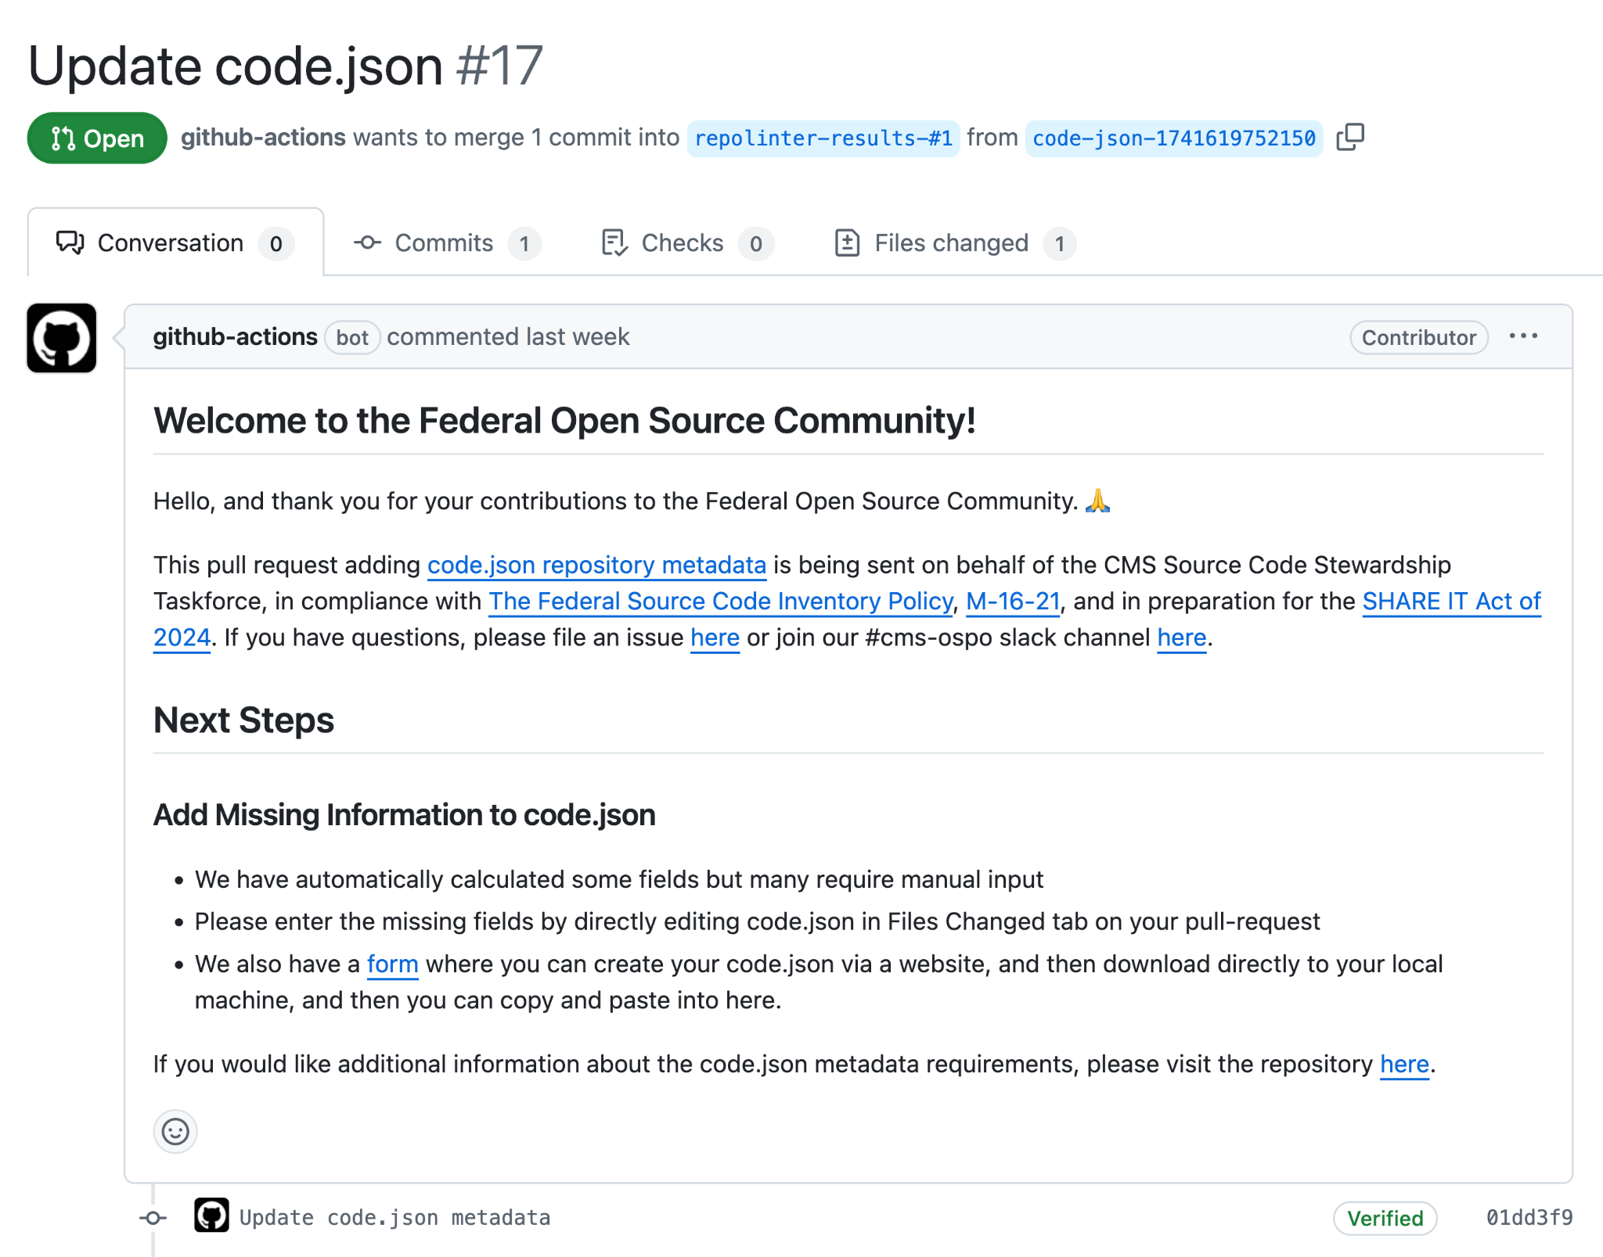
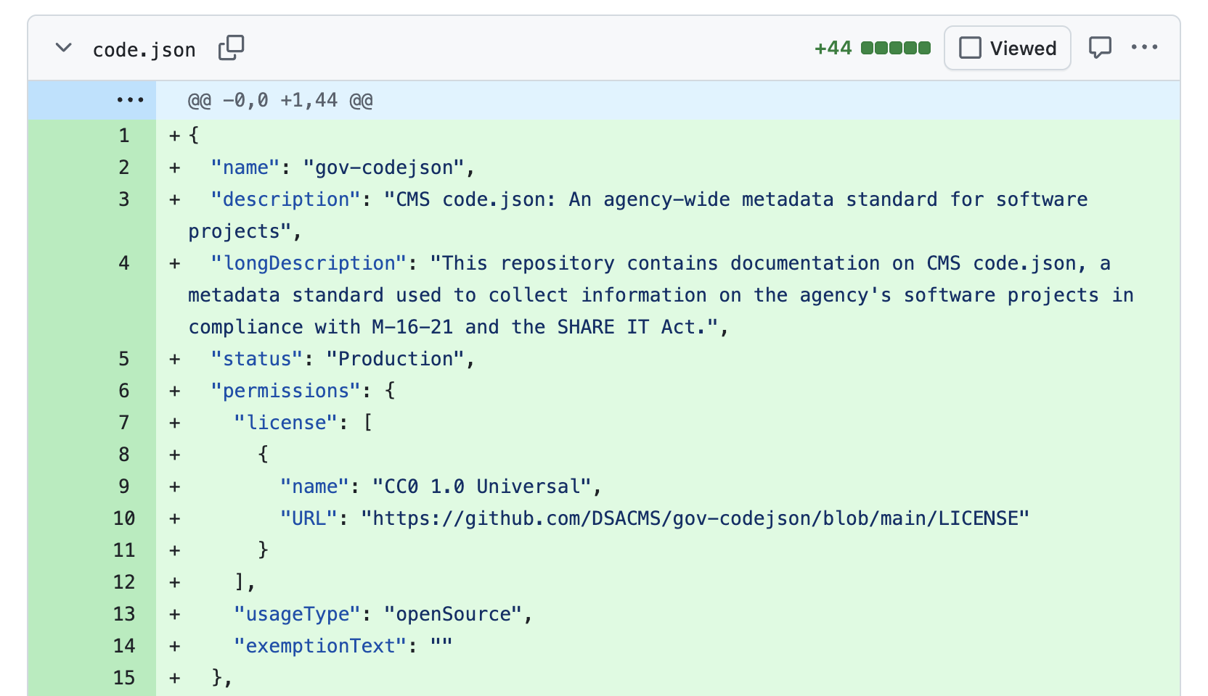
Automated-codejson-generator
automated-codejson-generator
Using Github Actions, users can automatically fill out portions of code.json, reducing burden for projects.
Users add our workflow to their repository, which can send a PR where users can then make manual edits on the web, instead of on the command line.
This automates making a repository SHARE IT Act compliant initially, and in the future, and improves user experience.
18
Notes:
Sachin

Slide 19
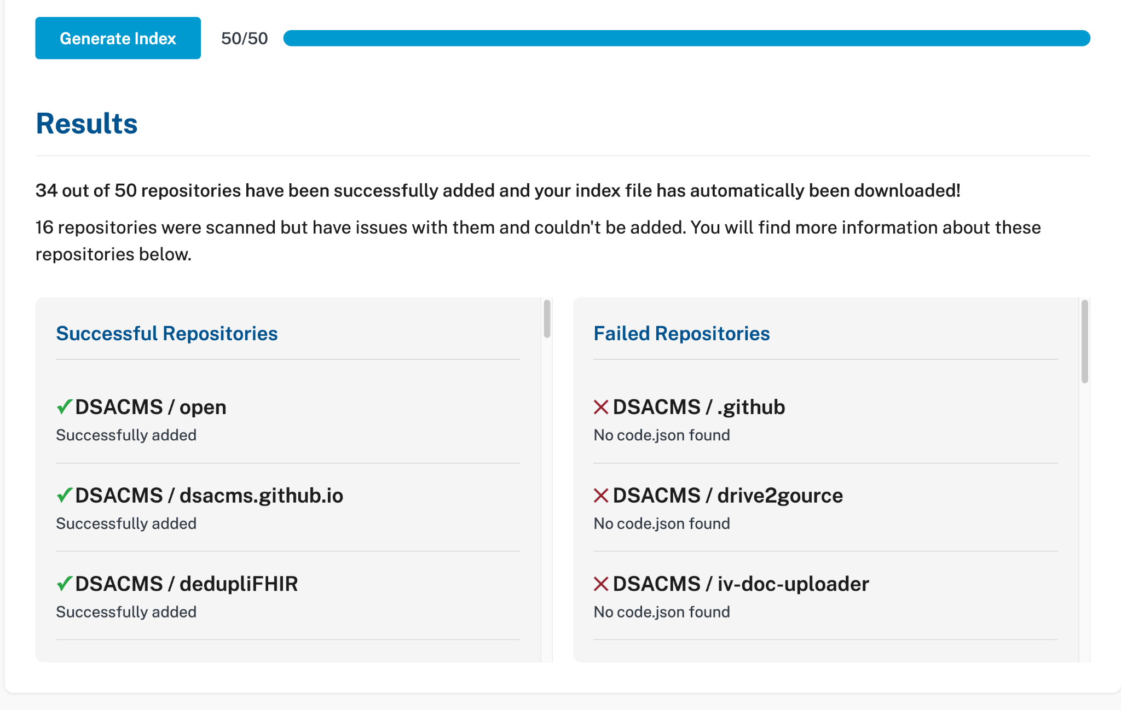
Codejson-index-generator
codejson-index-generator
The SHARE IT Act mandates Index files that aggregate metadata about all repositories on an agency level.
A new frontend tool that can aggregate all code.json files within all repos in all GitHub organizations within an agency, to create the mandated index file, reducing burden for CMS, HHS, and others.
Built into our Code.gov 2025 Rewrite using PyPi packaging and now supports multiple code forges.
19
Notes:
Isaac

Slide 20
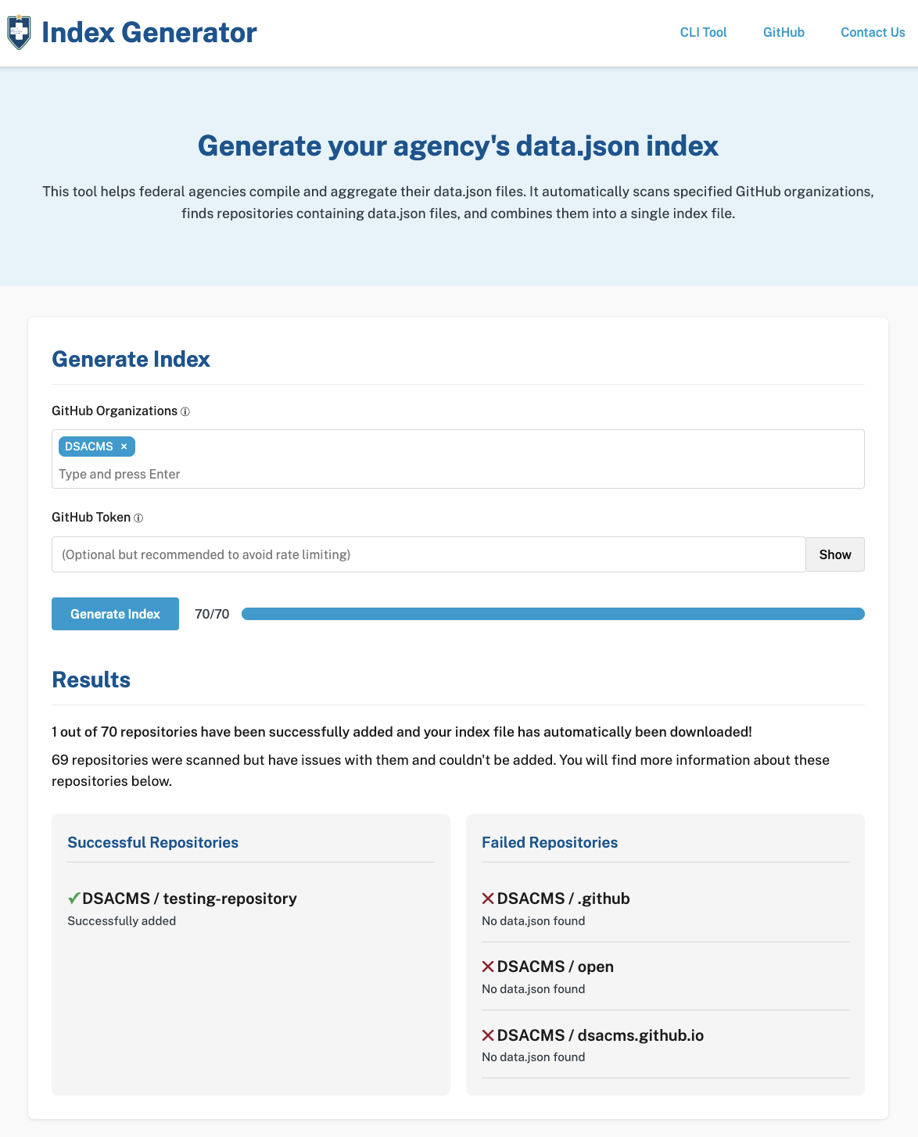
Bonus
BONUS: datajson-index-generator
Title II of The Evidence Act requires agency Open Data Plans to make Federal data publicly available by default, through comprehensive searchable data inventories of all agency data assets
The same frontend form we built to aggregate all code.json files was easily forked and modified to aggregate all data.json files as well!
This is a prime example of the power of modular open source development to reduce burden and costs through reuse! The express purpose of the SHARE IT Act!
20
Notes:
Isaac

Slide 21
Demo slide
Demo Time!

Slide 22
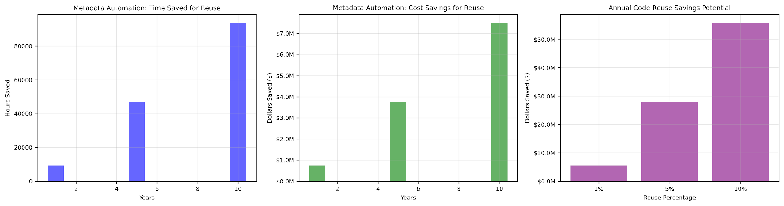
Estimated Savings: Metadata Tools & Repo Reuse
https://github.cms.gov/ospo/shareitsavings?tab=readme-ov-file#methodology
80% reduction, 1 hr per repository, 10K repos
$80/hr rate (GS 13/14 ~$100-150, Contractor ~$100-200)
CMS DME Budget of $700M, at 80% reuse efficiency
Period | Time Savings | Cost Savings
1 Year | 9,400 hrs | $752K (+$205K)
5 Years | 47,000 hrs | $3.76M
10 Years | 94,000 hrs | $7.52M
Reuse Rate | Cost Savings
1% reuse | $5M
5% reuse | $28M
10% reuse | $56M
CMS's annual IT spending for internal and contractor-operated systems was ~$2.8B (FY2023).
Operations & maintenance: ~$2.1B
Development, Modernization, & Enhancement: ~$700M
https://github.com/DSACMS/share-it-savings

Slide 23

Thank you slide
Thank You Formfest!
OSPO Landing Page: go.cms.gov/ospo
SHARE IT Act Landing Page: go.cms.gov/shareit
OSPO Email: opensource@cms.hhs.gov
Formfest Deck: github.com/DSACMS/decks/blob/main/formfest2025.pdf

